Slide 1
caGrid Data Services

Slide 2
Architecture Overview
Specialization of caGrid grid services to expose data through a common query interface
Present an object view of data sources
Exposed objects are registered in caDSR and their XML representation in GME
Queries made with CQL Query objects
Results returned as objects (or identifiers) nested in a CQL Query Result Set

Slide 3
Architecture (Continued)
Client receives CQLQueryResults object, which contains either Objects, Attributes, or Identifiers
Result set may be iterated with Data Service utility classes
Iteration over object results may return either deserialized objects or XML

Slide 4
Projects in CVS
Data
  CQL and Result Set schemas
  Source code for Common classes, Extension, Service, Validation, and Client Utilities
SDKQuery
  Implementation of CQL against caCORE SDK generated data sources
FQP
  Federated Query Processor

Slide 5
Queries
Queries to caGrid Data Services made with CQL
CQL
  Recursively defined
    Simplifies composition of existing queries to make more elaborate queries
  Follows UML representation of object model
    Straightforward querying given a model

Slide 6
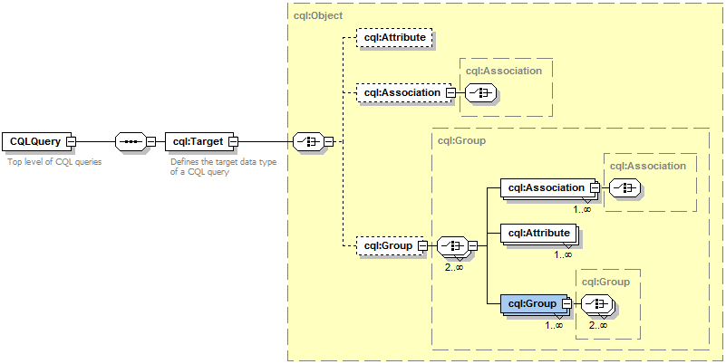
Queries (Continued)
CQL Defined by XML Schema
Primary types:
  Object
  Attribute
  Group
CQL is further described and demonstrated in the CQL usage document available in the caGrid Data Services project, under the docs directory.

Slide 7
Build Process
Data services can be built via an Introduce Toolkit extension
Extension adds functionality to both service creation and modification
  Creation adds query function
  Modification adds CQL implementation, selected data model, and appropriate metadata

